Slide 1
Data Science: Introduction (Lec 1,2,3)
Jaya Sil

Slide 2
Introduction
A fundamental change of Computer science is now focusing on wealth of applications.
The merging of computer and communication play an important role for such development.
The enhanced ability to observe, collect and store data in different fields like science, commerce, medical and others change our understanding of data.
Web, social media now are central aspects of our daily life and future research involves computers to understand.

Slide 3
Introduction
Understanding precise requirements of customers from the existing data, like the customer’s past browsing history, purchase history, age and income.
With the vast amount and variety of data, you can train models more effectively and recommend the product to your customers with more precision.
The Data Science plays role in decision making.
The self-driving cars collect live data from sensors (radars, cameras) to create a map of its surroundings and takes decisions like when to speed up, when to speed down, when to overtake, where to take a turn – making use of advanced machine learning algorithms.

Slide 4
Computational modeling
Computational modeling is the use of computers to simulate and study complex systems using mathematics, physics and computer science.
A computational model contains numerous variables that characterize the system being studied.
Simulation is done by adjusting the variables alone or in combination and observing the outcomes.
Computer modeling allows scientists to conduct thousands of simulated experiments by computer.
The thousands of computer experiments identify the handful of laboratory experiments that are most likely to solve the problem being studied

Slide 5
Data Modeling
Data Science can be used in predictive analytics.
Weather forecasting based on Data from ships, aircraft, radars, satellites, collected and analyzed to build the models.
These models not only forecast the weather but also help in predicting the occurrence of any natural calamities.
It helps to take appropriate measures beforehand and save many precious lives.
In reality, data science is evolving so fast and has already shown such enormous range of possibility that a wider definition is essential to understanding it.

Slide 6
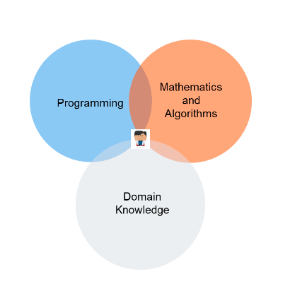
Data Science
Whether you work in medicine, media,
finance, or manufacturing, data
science will likely play a big
role moving forward.
Data science is the field of study
that combines domain expertise,
programming skills, and knowledge
of mathematics and statistics to extract
meaningful insights from data.

Slide 7
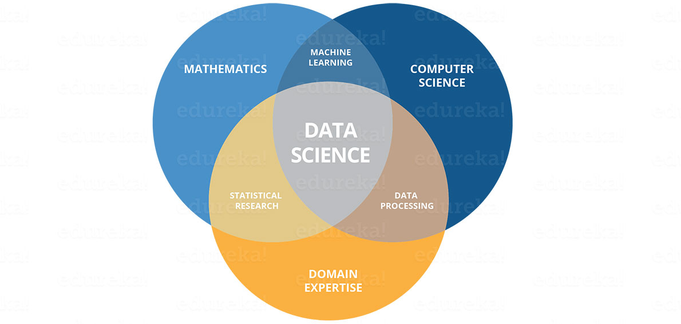
Introduction
Data science, in its most basic terms, can be defined as obtaining insights and information, really anything of value, out of data.
One of the major focus is now on probability, statistics and numerical methods.

Slide 8
Data Science Definition
Data Science is the science which uses computer science, statistics and machine learning, visualization and human-computer interactions to collect, clean, integrate, analyze, visualize, interact with data to create data products.
Goal of Data Science: Turn data into data products.
There have been many terms that have been used to describe such endeavors:
Statistics
Artificial Intelligence
Machine learning
Data analytics

Slide 9
Digital Data
In the context of data science, the only form of data that matters is digital data.
For example, the words on the screen are digital letters, formed by a systematic collection of ones and zeros that encodes to pixels in various hues and at a specific density.
To get to the point where the digital world would become intertwined with almost every person's life, data grow as big.
The term “big data” refers to data that is so large, fast or complex that it’s difficult or impossible to process using traditional methods.

Slide 10
Big Data
Definition of big data as the three V’s: Volume, Velocity, Variety.
Volume: Organizations collect data from different sources.
Velocity: With the growth in the Internet of Things, data streams into businesses at an unprecedented speed and must be handled in a timely manner. RFID tags, sensors and smart meters are driving the need to deal with these torrents of data in near-real time.
Variety: Data comes in all types of formats – from structured, numeric data in traditional databases to unstructured text documents, emails, videos, audios, stock ticker data and financial transactions.

Slide 11
Additional dimensions
Variability: In addition to the increasing velocities and varieties of data, data flows are unpredictable – changing often and varying greatly.
Veracity: Veracity refers to the quality of data. Because data comes from so many different sources, it’s difficult to link, match, cleanse and transform data across systems.
Businesses need to connect and correlate relationships, hierarchies and multiple data linkages. Otherwise, their data can quickly spiral out of control.

Slide 12
Big Data Anlytics
Big Data Anlytics refers to the process of collecting, organizing, analyzing large data sets to discover different patterns and other useful information.
A set of technologies and techniques are required to disclose correlation, hidden patterns from large datasets that are more complex, and of a large enormous scale.
Example of big data Analytics are big online business website like Flipkart, snapdeal uses Facebook or Gmail data to view the customer information or behaviour.

Slide 13
Text analytics
Text analytics or text mining refers process of deriving important information from text data.
It use many ways like associations among entities, predictive rules, patterns, concepts, events etc. based on rules.
Data simply tells you what people did but text analytics tell you why.
From unstructured or semi structured text data all information will retrieve.
After extracting information it will be categorized and we can take decision.

Slide 14
AUDIO ANALYTICS
Audio analytics is the process of compressing data and packaging the data into single format called audio.
Audio Analytics refers to the extraction of meaning and information from audio signals for Analysis.
There are two way to represent the audio Analytics is 1) Sound
Representation 2) Raw Sound Files.
Audio file format is a format for store digital audio data on a
system.
Three main audio format: Uncompressed audio format, Lossless compressed audio format, Lossy compressed audio format.

Slide 15
Big Data Features
An experienced data scientist can easily pick out what is and what is not big data.
For example, all of the photos you have on your phone is not big data. However, all of the photos uploaded to Facebook everyday.
To get to the data driven world, we needed scale, speed, and ubiquity.
The most recent big innovation has been The Cloud. The cloud, from a storage perspective, is data that is distributed across many different hard drives.

Slide 16
Scaling
Scaling is defined as the ability for an IT resource to handle growing or decreasing demands in a capable manner, as businesses can scale up or down to meet the demands.
Companies like Amazon and Dropbox build a network of hard drives, and talking to each other and understanding what data is where. This allows for massive scaling because it's usually easy to add another drive to the system.
Cloud computing uses a pay-as-you-go model, i.e. on-demand nature.
We can start small and adjust. It’s quick, easy, and we’re in control.

Slide 17
Speed
Speed, the second point of the big data revolution involves how, and how fast we can move.
The speed at which the data is generated and processed to meet the demands and challenges that lie in the path of growth and development. Big data is often available in real-time. Compared to small data, big data is produced more continually.
The combination of increased speed and storage capabilities incidentally led to the final component of the big data story around and compute with data.
The most important event on the path to big data is not in fact the infrastructure to handle that data, but the ubiquity of the devices that generate it.

Slide 18
Sources of big data
Streaming data comes from the Internet of Things (IoT) and other connected devices that flow into IT systems from wearables, smart cars, medical devices, industrial equipment and more.
Social media data stems from interactions on Facebook, YouTube, Instagram, etc. This data is often in unstructured or semistructured forms, so it poses a unique challenge for consumption and analysis.
Publicly available data and other sources like cloud.

Slide 19
Data Analyst
With so many different ways to get value from data, categorization will help make the picture a little clearer.
Data analysis, the first subcategory of data science.
Though it is true of all aspects of data science, data analysis in particular is dependent on context.
You have to understand how data came to be and what the goals of the underlying business or process are in order to do good analytic work.

Slide 20
Data Representation
Data in diverse fields often advantageous to represent as vectors with high dimensionality.
Geometric (length, dot products, orthogonality etc.) and linear algebra are useful to handle data.
Singular value decomposition (SVD) is used to deal with matrix data.
For understanding large structures like web, social networks, we need building models to capture essential properties of these structures.

Slide 21
Data Quality
Data quality refers to the state of qualitative or quantitative pieces of information.
Data quality is a measure of the condition of data based on factors: accuracy, completeness, consistency, reliability and up to date.
Measuring data quality levels can help organizations to identify data errors that need to be resolved and assess whether the data in their IT systems is fit to serve its intended purpose.
Data quality management is a core component of data management process, and data quality improvement often closely tied to data governance programs that aim to ensure data is formatted and used consistently throughout an organization.

Slide 22
Data Quality
Data accuracy is a key attribute of high-quality data.
Inaccurate data needs to be identified, documented and fixed to ensure that executives, data analysts and other end users are working with good information.
Elements of good data quality include data completeness, with data sets; data consistency, where there are no conflicts between the same data values in different systems or data sets; a lack of duplicate data records in databases.
Data has been updated as needed to keep it current; and conformity to the standard data formats

Slide 23
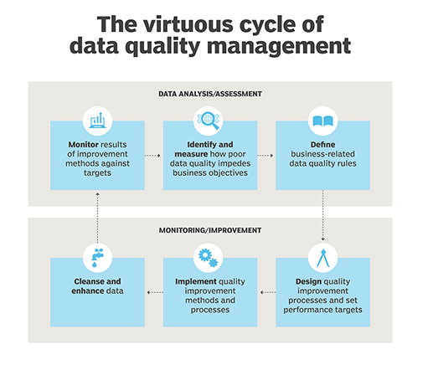

Slide 24
Data Quality
1) Poor Organization➔Data Representation
If you’re not able to easily search through your data, you’ll find that it becomes significantly more difficult to make use of. Through different organizational methods and procedures, there are dozens of ways that data can be represented.
2) Too Much Data➔Useable Data
There is often too much data to properly work and many of them simply isn’t usable. More time is spending to dig through the bad so they can get to the good.
3) Inconsistent Data➔Removal of Duplicate Data
When dealing with multiple data sources, inconsistency is a big indicator that there’s a data quality problem. Same records might exist multiple times in a database.

Slide 25
Data Quality
4) Poor Data Security
Lack of handling data in a professional and secure manner. When working with customer data, there must always be precautions in place to make sure that it can’t be used for theft, fraud and spam.
5) Poorly Defined Data
Oftentimes data is poorly defined, which causes great confusion around the proper methodology for management. For example, data that’s sectioned into the wrong category, like a company account being filed as a single person’s contact, is going to really mess things up in your database and make the whole thing more difficult to understand and sort through.

Slide 26
Data Quality
6) Incorrect Data
Data decays at a rate of 2.2% per month, therefore, data is being outdated results 10 to 25% of existing data in the system has errors within it.
7) Poor Data Recovery
People generally spend 30% of their time with data just looking for the data they need. Even worse- in 40% of searches, people never even find the data that they were looking for in the first place.
RingLead is the only full stack data solution that can enrich existing/incoming data while getting rid of the duplicate data in a database.

Slide 27
How to determine data quality?
As a first step toward determining their data quality levels, organizations typically perform data asset inventories in which the relative accuracy, uniqueness and validity of data are measured in baseline studies.
The established baseline ratings for data sets can then be compared against the data in systems on an ongoing basis.
Another common step is to create a set of data quality rules based on business requirements for both operational and analytics data.
Such rules specify required quality levels in data sets and detail what different data elements need to include so they can be checked for accuracy, consistency and other data quality attributes.

Slide 28
5 characteristics of quality data
Validity. The degree to which your data conforms to defined business rules or constraints.
Accuracy. Ensure your data is close to the true values.
Completeness. The degree to which all required data is known.
Consistency. Ensure your data is consistent within the same dataset and/or across multiple data sets.
Uniformity. The degree to which the data is specified using the same unit of measure.

Slide 29
Methodologies for assessments
Data Quality Assessment Framework (DQAF) for healthcare services provides guidelines for measuring data quality dimensions that include completeness, timeliness, validity, consistency and integrity.
The International Monetary Fund (IMF), which oversees the global monetary system and lends money to economically troubled nations, has also specified an assessment methodology.
This framework focuses on accuracy, reliability, consistency and other data quality attributes in the statistical data that member countries submit to the IMF.

Slide 30
Data quality vs. data integrity
Data integrity is the assurance that digital information is uncorrupted and can only be accessed or modified by authorised people.
Data integrity is seen as a broader concept that combines data quality, data governance and data protection mechanisms to address data accuracy, consistency and security as a whole.
Data integrity focuses on Logical integrity that includes data quality measures and database attributes.
Physical integrity involves access controls and other security measures designed to prevent data from being modified or corrupted by unauthorized users, as well as backup and disaster recovery protections.

Slide 31
Why is data preprocessing required?
Real world data is generally:
Incomplete: Certain attributes or values or both are missing, or only aggregate data is available.
Noisy: Data contains errors or outliers
Inconsistent: Data contains differences in codes or names etc.
Data preprocessing is a data mining technique that transforms raw data into a more understandable, useful and efficient format.

Slide 32
Data Preprocessing
Data cleaning process detects and removes the errors and inconsistencies present in the data and improves its quality.
Data quality problems occur due to misspellings during data entry, missing values or any other invalid data.
Work to enhance data sets by adding missing values, more up-to-date information or additional records.
The choice of technique to deal with missing data depends on the problem domain and the goal of data mining process.

Slide 33
Different ways to handle missing data
Ignore the data row: This method is suggested for records where maximum amount of data is missing, rendering the record meaningless.
This method is usually avoided where only less attribute values are missing.
If all the rows with missing values are ignored i.e. removed, it will result in poor performance.
Use a global constant to fill in for missing values: A global constant like “NA” or 0 can be used to fill all the missing data. This method is used when missing values are difficult to be predicted.

Slide 34
Different ways to handle missing data
Use attribute mean or median: Mean or median of the attribute is used to fill the missing value.
Use forward fill or backward fill method: In this, either the previous value or the next value is used to fill the missing value. A mean of the previous and succession values may also be used.
Use a data-mining algorithm to predict the most probable value

Slide 35
Handle Noise and Outliers
Noise in data may be introduced due to fault in data collection, error during data entering or due to data transmission errors, etc.
Unknown encoding (Example : Marital Status — Q),
out of range values (Example : Age — -10),
Inconsistent Data (Example : DoB — 4th Oct 1999, Age — 50),
Inconsistent formats (Example : DoJ — 13th Jan 2000, DoL — 10/10/2016), etc..

Slide 36
Handle Noise and Outliers
Noise can be handled using binning.
Sorted data is placed into bins or buckets, can be created by equal-width (distance) or equal-depth (frequency) partitioning.
Smoothing can be applied by bin mean, bin median or bin boundaries.
Clustering can be used to identify groups of outlier data.
The detected outliers may be smoothed or removed.

Slide 37
Remove Unwanted Data
Unwanted data are generated when scraping data from different sources and then integrating.
This procedure may lead to some duplicate data if not done efficiently. is duplicate or irrelevant data.
This redundant data should be removed as it is of no use and will only increase the amount of data and the time to train the model.
Also, due to redundant records, the model may not provide accurate results as the duplicate data interferes with analysis process, giving more importance to the repeated values.

Slide 38
Steps of Data Cleaning
Step 1: Remove duplicate or irrelevant observations.
Step 2: Fix structural errors
Step 3: Filter unwanted outliers
Step 4: Handle missing data
Step 5: Validate
At the end of data cleaning process, questions to answer as a part of basic validation:
Does the data make sense?
Does the data follow the appropriate rules for its field?
Does it prove or disprove your working theory, or bring any insight to light?
Can you find trends in the data to help you form your next theory?
If not, is that because of a data quality issue?

Slide 39
Benefits of data cleaning
Benefits include:
Removal of errors when multiple sources of data are at play.
Monitoring errors and better reporting to see where errors are coming from, making it easier to fix incorrect or corrupt data for future applications.
Using tools (Software like Tableau Prep) for data cleaning will make for more efficient business practices and quicker decision-making.
Clean data will ultimately increase overall productivity and allow for the highest quality information in your decision-making.

Slide 40
Data Integration involves integrating data from multiple sources. The data sources can be homogeneous or heterogeneous, structured, unstructured or semi-structured in format.
Data transformation is the process of converting data from one format or structure into another.
Transforming and mapping data from one "raw" data form into another format for analyzing.

Slide 41
Data Integration
A coherent data source is prepared by integrating data.
Schema Integration: Metadata (i.e. the schema) from different sources may not be compatible. This leads to entity identification problem.
Example : Consider two data sources R and S. Customer id in R is cust_id and in S is c_id, represent the same thing but have different names which leads to integration problems.
Detecting and resolving them is very important to have a coherent data source.

Slide 42
Data value conflicts
The values or metrics or representations of the same data maybe different for the same real-world entity in different data sources.
This leads to different representations of the same data, different scales etc.
Example : Weight in data source R is represented in kilograms and in source S is represented in grams.
To resolve this, data representations should be made consistent and conversions should be performed accordingly.

Slide 43
Redundant data
Duplicate attributes or tuples may occur as a result of integrating data from various sources.
This may also lead to inconsistencies.
These redundancies or inconsistencies may be reduced by careful integration of data from multiple sources.
This will help in improving the mining speed and quality. Also, co-relational analysis can be performed to detect redundant data.

Slide 44
Data Reduction
The number of records or the number of attributes or dimensions can be reduced.
Reduction is performed by keeping in mind that reduced data should produce the same results as original data.
Dimensionality reduction: The data attributes or dimensions are reduced.
Suitable subset of attributes are selected by using data mining techniques.

Slide 45
Data compression
Large volumes of data is compressed i.e. the number of bits used to store data is reduced.
This can be done by using lossy or lossless compression.
In loss compression, the quality of data is compromised for more compression.
In lossless compression, the quality of data is not compromised for higher compression level.

Slide 46
Numerosity reduction
This technique reduces the volume of data by choosing smaller forms for data representation.
Numerosity reduction can be done using histograms, clustering or sampling of data.
Numerosity reduction is necessary as processing the entire data set is expensive and time consuming.

Slide 47
Data Discretization
It is considered as a part of data reduction.
Data discretization is defined as a process of converting continuous data attribute values into a finite set of intervals and associating with each interval some specific data value.
A set of contiguous intervals (or bins) are created that go across the range of desired variable/model/function.
Often, it is easier to understand continuous data (such as weight) when divided and stored into meaningful categories or groups.
For example, we can divide a continuous variable, weight, and store it in the following groups : Under 100 lbs (light), between 140–160 lbs (mid), and over 200 lbs (heavy)

Slide 48
Interprets Features
Continuous features have a smaller chance of correlating with the target variable due to infinite degrees of freedom and may have a complex non-linear relationship.
Difficult to interpret an such a function. After discretizing a variable, groups corresponding to the target can be interpreted.
When we discretize a model, we are fitting it to the bins and reducing the impact of small fluctuation in the data.
Often, we would consider small fluctuations as noise. We can reduce this noise through discretization.

Slide 49
Approaches to Discretization
Equal-Width Discretization
bins have equal width with a range of each bin are defined as [min + w], [min + 2w] …. [min + nw] where
w = (max – min) / (no of bins)
Equal-Frequency Discretization
we divide the range [A, B] of the variable into intervals that contain (approximately) equal number of points.
The main challenge in discretization is to choose the number of intervals or bins and how to decide on their width.

Slide 50
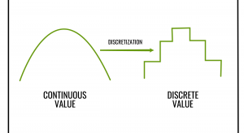

Slide 51
How to perform smoothing on the data?
Smoothing by bin means : In smoothing by bin means, each value in a bin is replaced by the mean value of the bin.
Smoothing by bin median : In this method each bin value is replaced by its bin median value.
Smoothing by bin boundary : In smoothing by bin boundaries, the minimum and maximum values in each bin are identified as the bin boundaries. Each bin value is then replaced by the closest boundary value.

Slide 52
Sorted data for price(in dollar) : 2, 6, 7, 9, 13, 20, 21, 25, 30
Partition using equal frequency approach:
Bin 1 : 2, 6, 7
Bin 2 : 9, 13, 20
Bin 3 : 21, 24, 30
Smoothing by bin mean :
Bin 1 : 5, 5, 5
Bin 2 : 14, 14, 14
Bin 3 : 25, 25, 25

Slide 53
Data scientists
Data scientists are those who crack complex data problems with their strong expertise in certain scientific disciplines.
They work with several elements related to mathematics, statistics, computer science, etc.
Data Scientists present the data in a much more useful form as compared to the raw data available to them from structured as well as unstructured forms.

Slide 54
Data Scientist
Data Scientists help build complicated data models and simulations in a Big Data environment.
Focusing more on math and statistics, these data scientists have a particular interest in reading statistics and building & deploying machine learning models.
Python is one of the most sought-after tool by companies followed by R.
Big Data Analyst include collaborating with data scientists and data architects to ensure streamlined implementation of services and executing big data processes.

Slide 55
Job Roles
Business Analytics Professional: A business analytics professional has the skills to make use of the information from the data to generate insights about the business.
Business Intelligence Professional: A Business Intelligence Professional analyses the past trends using Data Visualization tools like Tableau, Power BI etc to develop and implement business strategies.
HR Analytics Professionals: HR Analytics professionals are working on how to reduce employee attrition rate, finding out the best recruitment channels and solving appalling problems related to HR Function.

